Slide 1

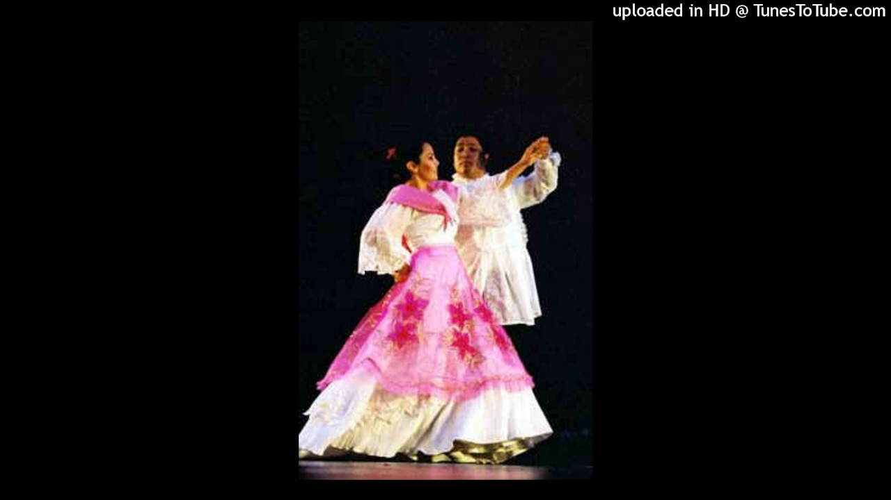
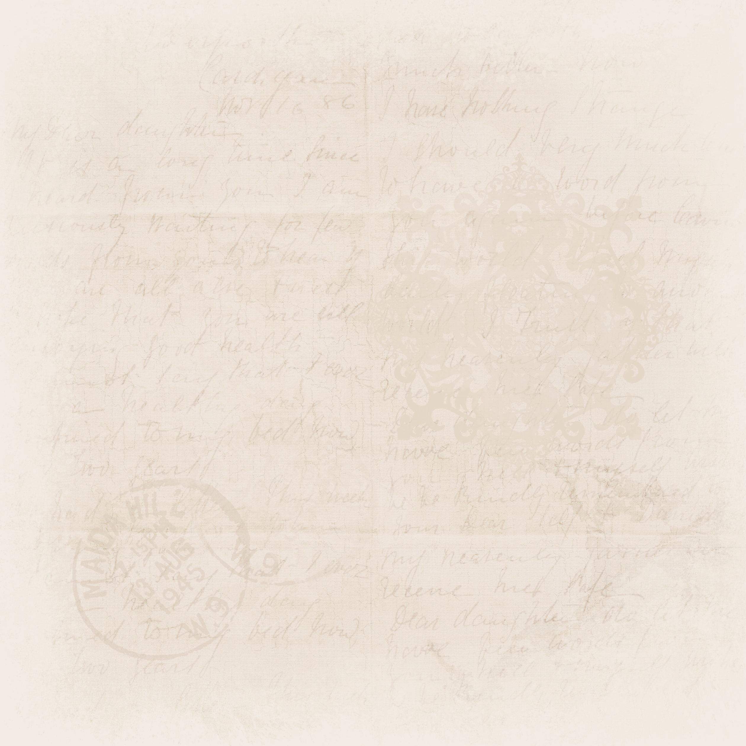
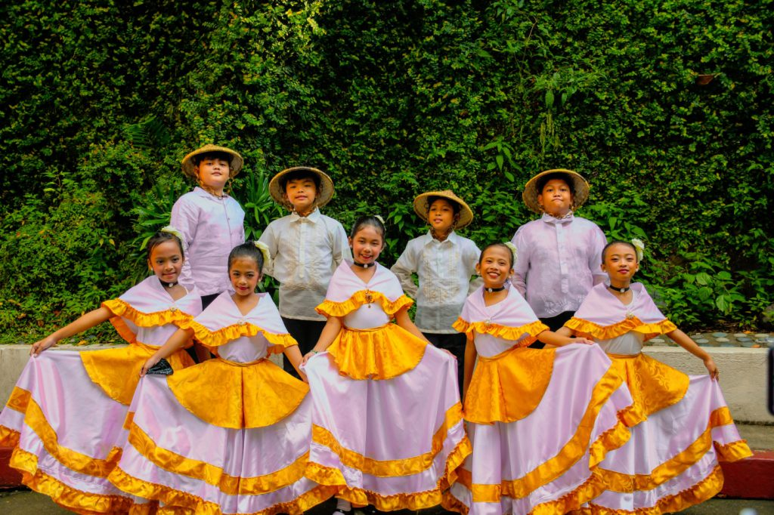
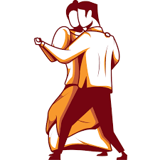
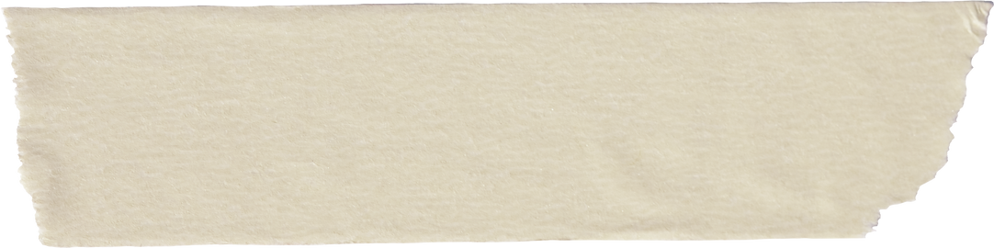
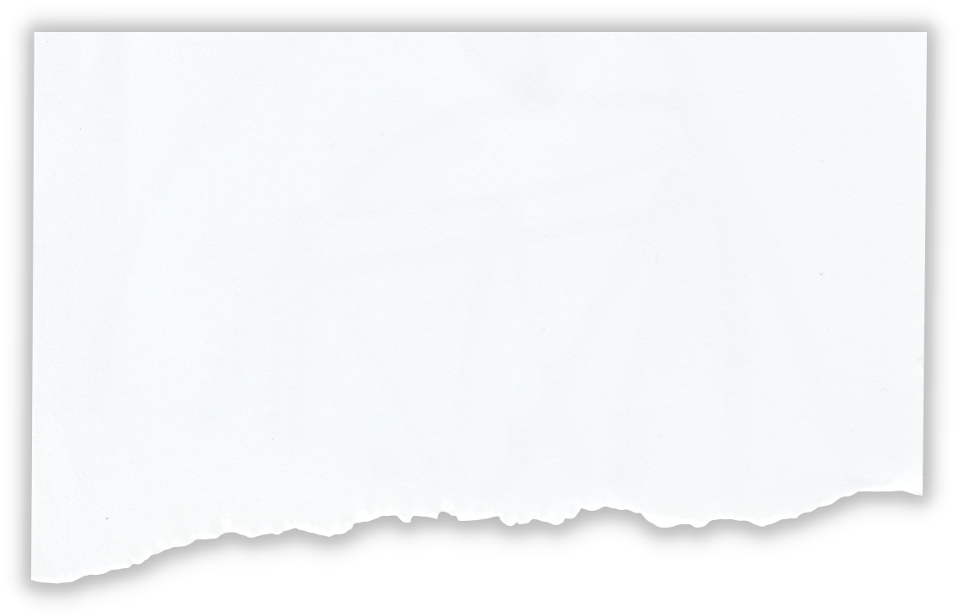

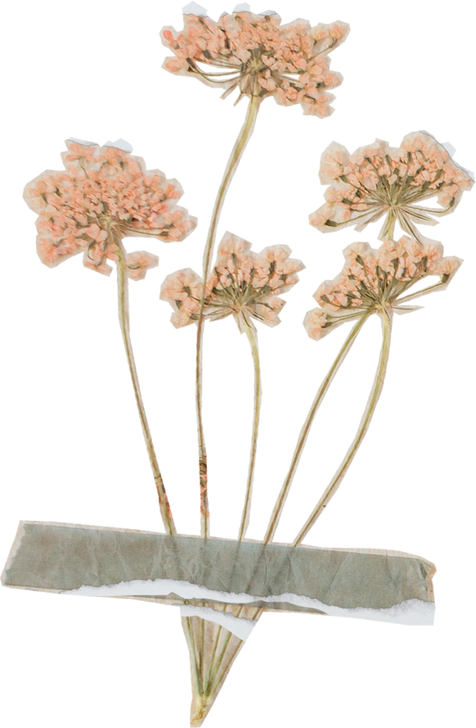
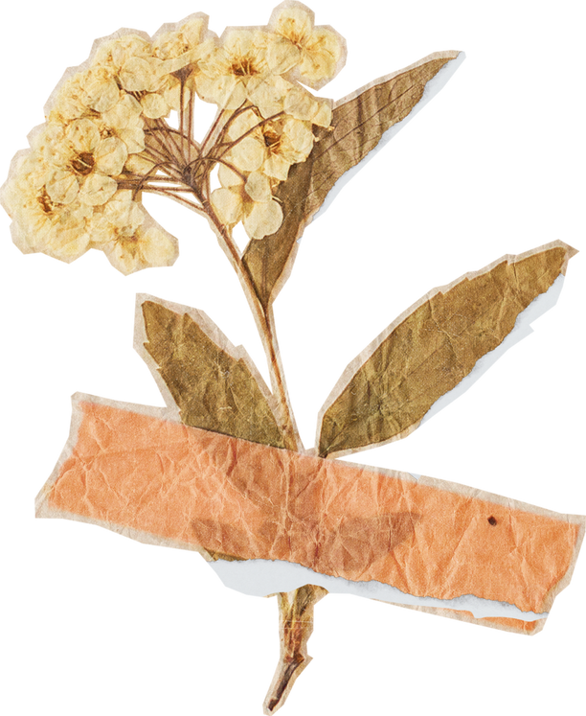
POLKA SA NAYON
WEEK 7

Slide 2


Characteristics
polka sa nayon

Slide 3
Origin
polka sa nayon
Polka sa Nayon is a traditional Filipino folk dance that is performed during cultural events and celebrations. Polka sa Nayon is a reflection of the rural and joyful aspects of the Filipino life. It is characterized as lively and energetic often accompanied by music that is played on the Filipino traditional instruments. But the true origins of the Polka Dance can be traced back to European roots.

Slide 4

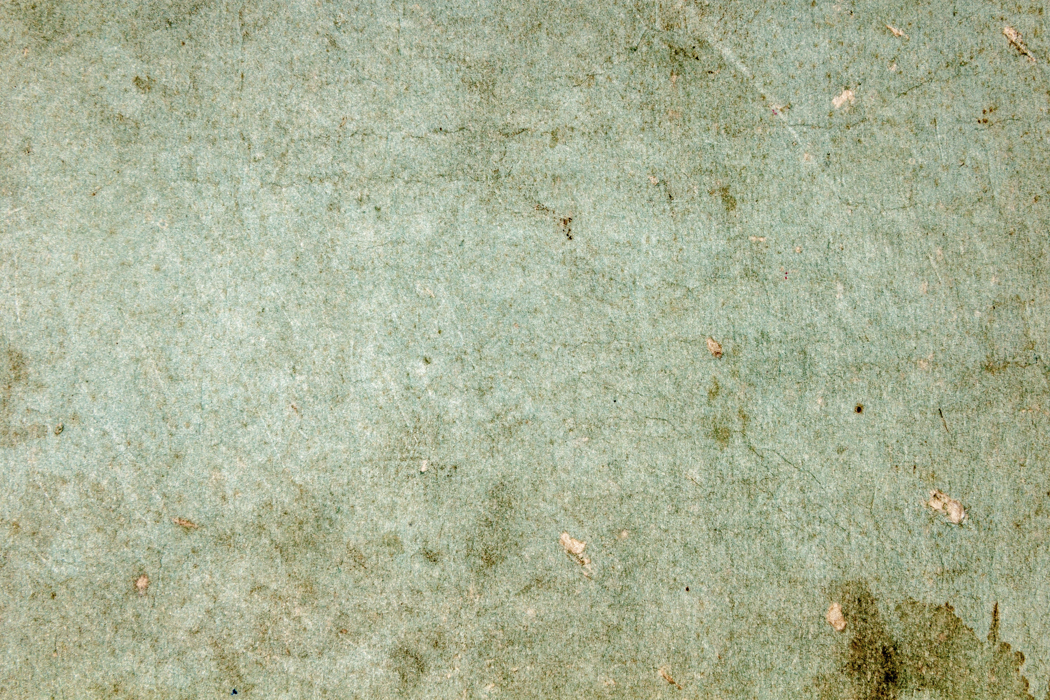

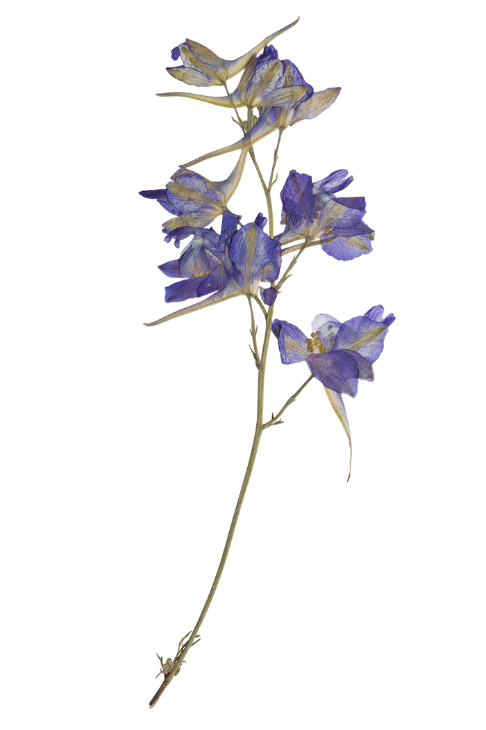
Characteristics
polka sa nayon
Rhythmic and Lively
Partner Dance
The dance is typically performed by a male and female pair. The dancers hold each other's hands or wrists and move in coordinated steps and patterns. The interaction between the partners is an important aspect of the dance.
"Polka sa Nayon" is known for its lively and upbeat rhythm. It features a brisk tempo that encourages dancers to move energetically and engage in lively footwork.

Slide 5
Characteristics
polka sa nayon
Simple
Footwork
Traditional Costumes
The footwork in "Polka sa Nayon" is usually uncomplicated, involving simple steps and lively hops or skips. This simplicity allows a wider range of people to participate and enjoy the dance
Dancers often wear traditional Filipino attire, such as baro't saya for women and barong Tagalog for men. These colorful and elegant costumes add to the visual appeal of the dance.

Slide 6
Characteristics
polka sa nayon
Cultural Representation
Polka sa Nayon represents the cultural identity of the specific regions and communities within the Philippines. It incorporates music, dance steps, and attire that reflects local tradition.

Slide 7
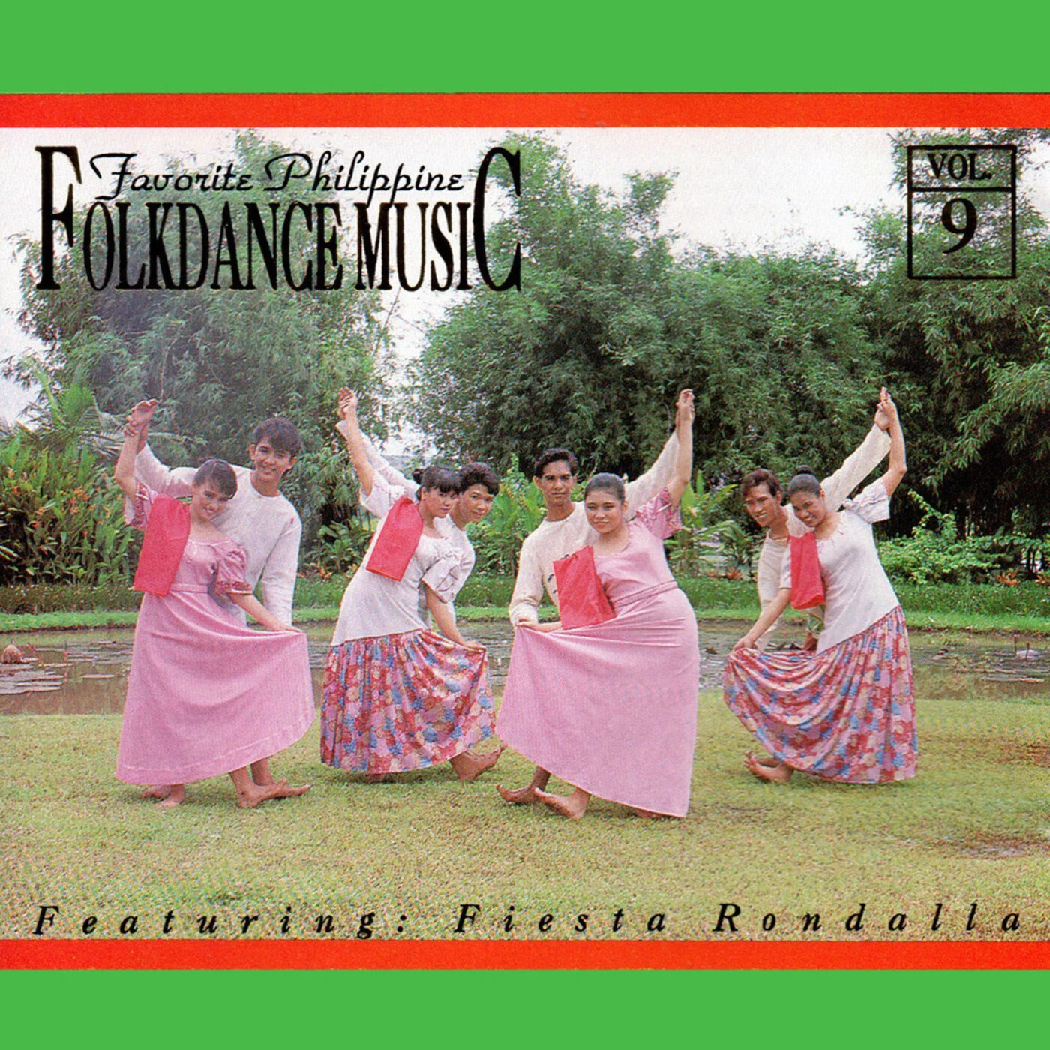
Movement skills
polka sa nayon

Slide 8
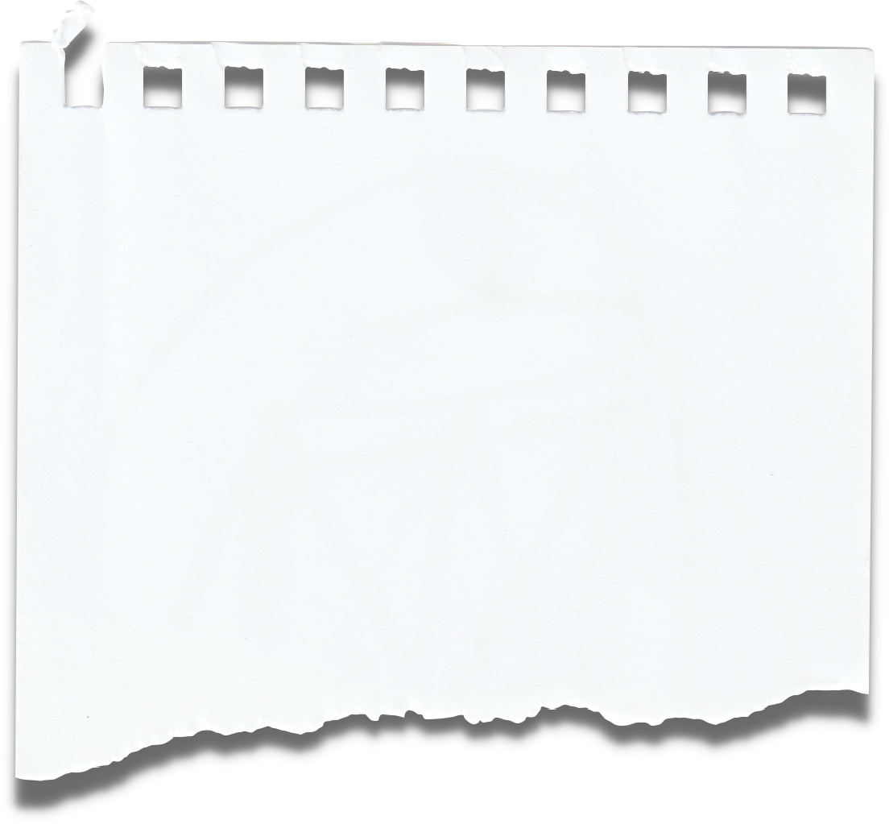
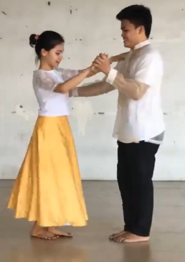
Dance Steps
FORM 1
FORM 1.A
FORM 1.B
FIGURE 1
The dancers face the audience, inside hands joined, free hand of Girl holding skirt while the Boy places his hands on his waist
Both dancers tap right foot on every count of the measure. (8 measures)
Partners get ready for the position and holds their position.
Refer to Figure 1.

Slide 9
Dance Steps
FORM 2
FORM 2.A
FORM 2.B
FORM 2.C
Starting with Left for men and Right for Women foot, take 4 polka steps around clockwise finishing in original position. (4 measures).
Point the Left foot sideward for men and Right foot sideward for women and close back to Right for Men and Left for women
Take one polka step sideward. Left for men and Right for women. (2 measures).
Repeat (2.A - 2.B) staring with Right foot for Men and Left for Women.

Slide 10
Dance Steps
FORM 2.D
Repeat all FORM 2 for 3 more times.

Slide 11
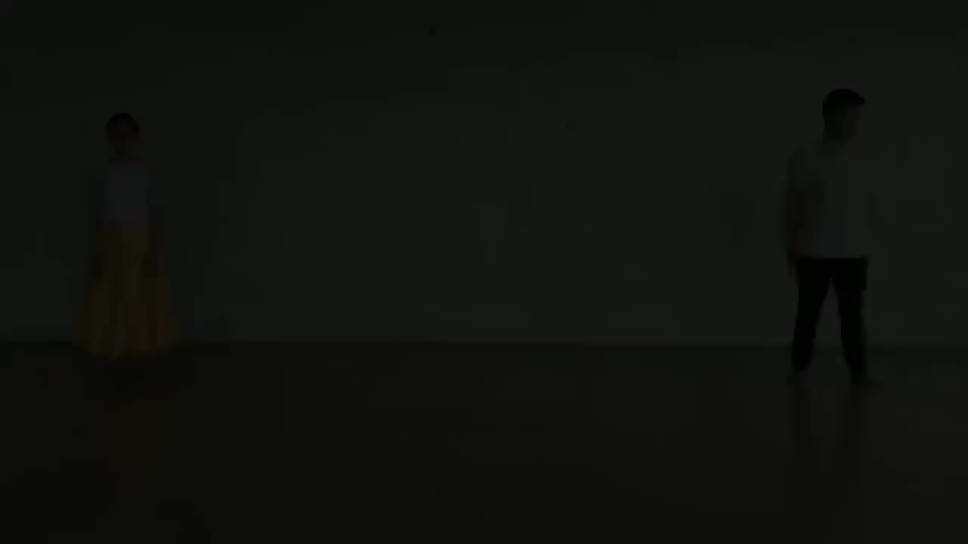
Example Video

Slide 12
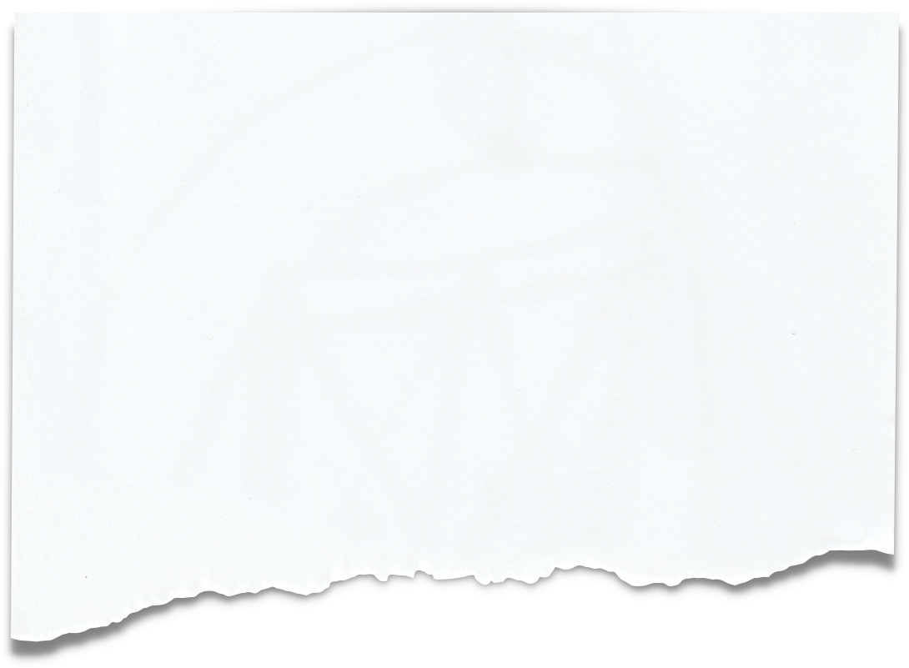

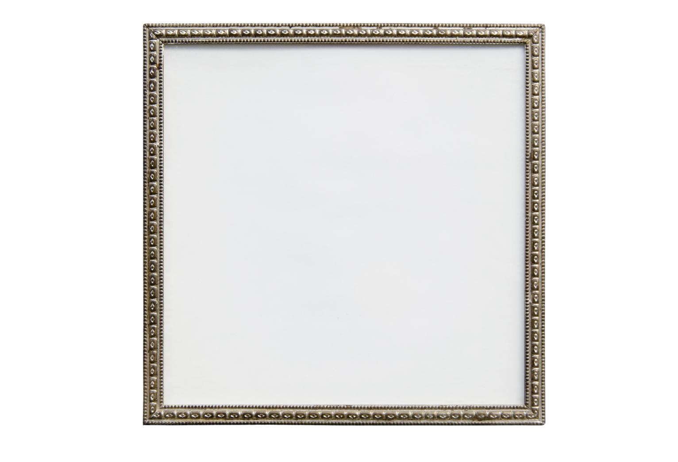
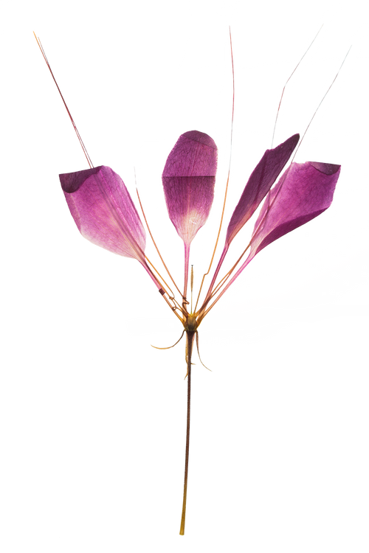
Movement Skill
Basic Steps
Learn the basic steps of the dance, which involve simple hopping, skipping, and side-to-side movements.
Balance
Maintain balance and stability while performing the dance steps. Some movements might require quick shifts of weight from one foot to another, so having good balance will help you execute the steps smoothly.
Coordination
Develop good coordination between your upper body, arms, and lower body movements.
Rhythm and Timing
Master the rhythm and timing of the dance.

Slide 13
Movement Skill
Posture
Maintain good posture while dancing. This not only enhances the overall appearance of the dance but also helps in executing the movements correctly and comfortably.
Partner Interaction
In some versions of Polka sa Nayon, dancers interact with a partner.
Expression and Energy
Infuse the dance with energy and enthusiasm.

Slide 14
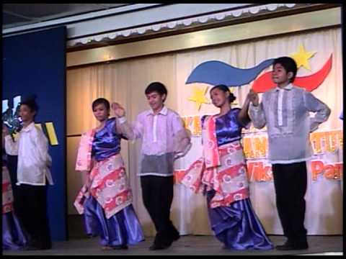
Fitness benefits
polka sa nayon

Slide 15

Fitness benefit
CARDIOVASCULAR FITNESS
COGNITIVE BENIFITS
MUSCULAR ENDURANCE
MENTAL HEALTH
Regular participation in Polka sa Nayon may contribute to better heart health and circulation since it involve rhythmic and energetic movements that elevates the participants heart rate which results in improved cardiovascular health
Since Polka sa Nayon has repetitive movements, it still has numerous steps that's needed to be remembered. In doing so, it improves ones cognitive functions such as memory concentration and coordination.
There are many repetitive movements in Polka sa Nayon, which results in various muscle engagements. Over time, these movements contribute to muscular endurance by conditioning and strengthening the engaged muscles or muscle group.
since polka sa nayon is typically performed by a male and female pair, this results in social interactions which may improve mental health and manage stress.

Slide 16
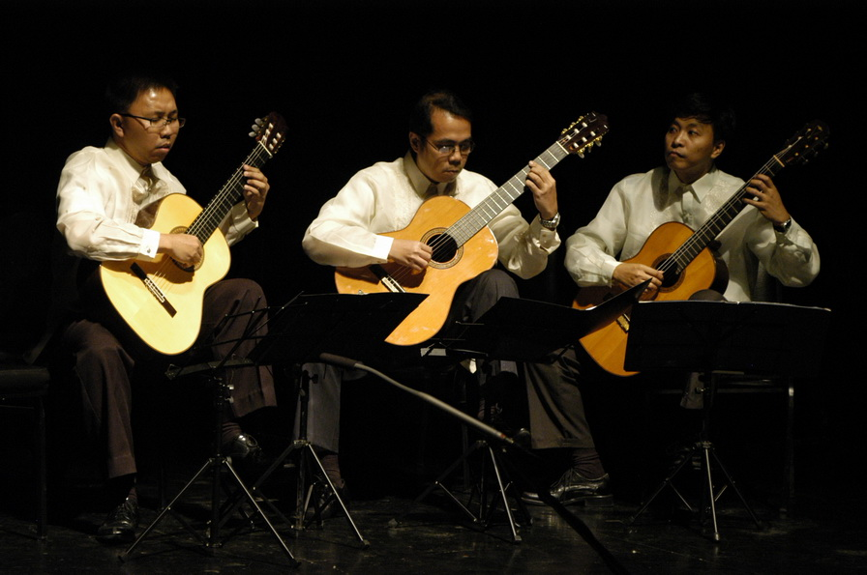
Dietary goals
polka sa nayon

Slide 17
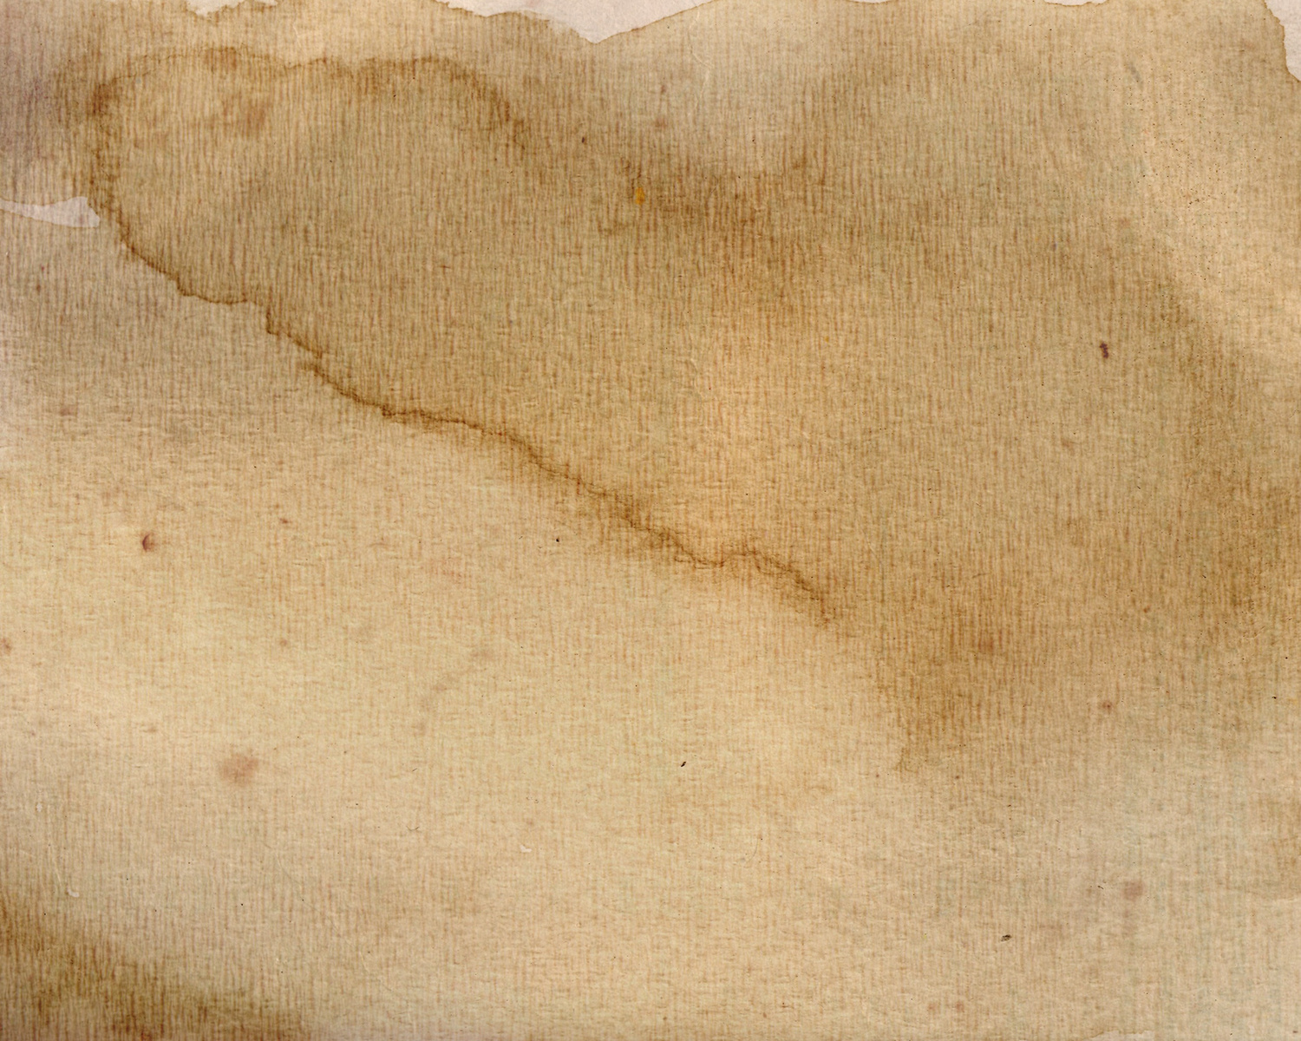
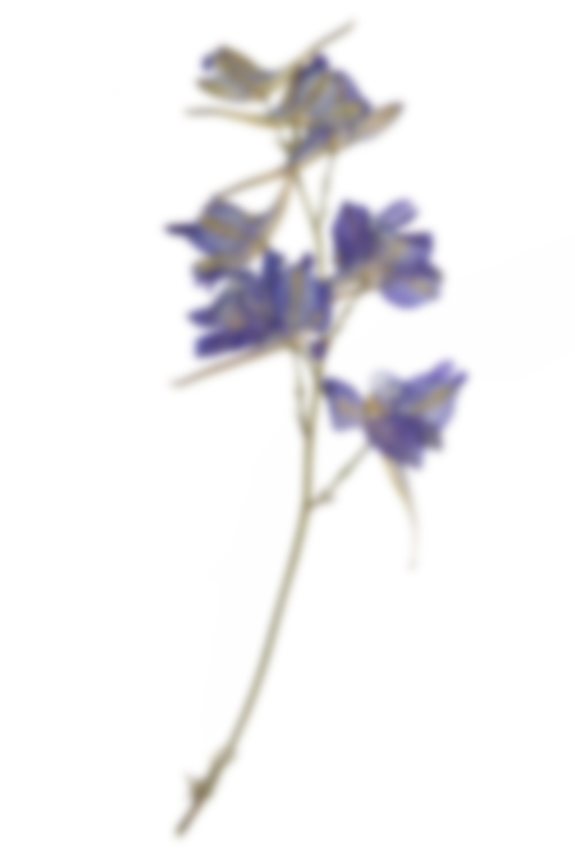
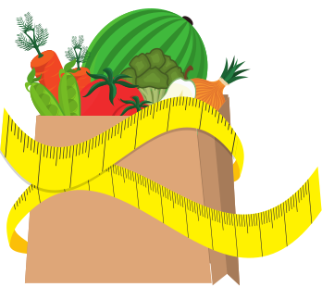
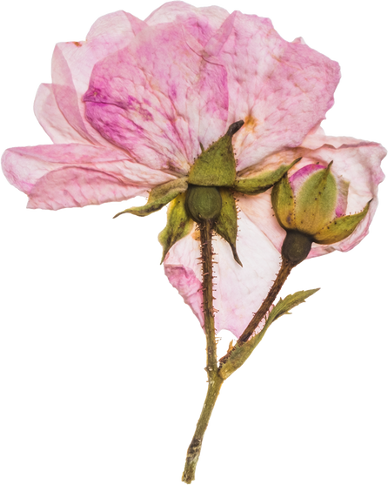
Dietary Goals
SUPPORT
FOCUS
REMEMBER
Maintaining a balanced diet and staying hydrated would generally be beneficial to support your energy levels and overall well-being during the performance.
Focus on consuming a mix of carbohydrates, proteins, and healthy fats, along with plenty of fruits and vegetables.
Remember to drink enough water to stay hydrated, especially if you're dancing for an extended period of time.

Slide 18

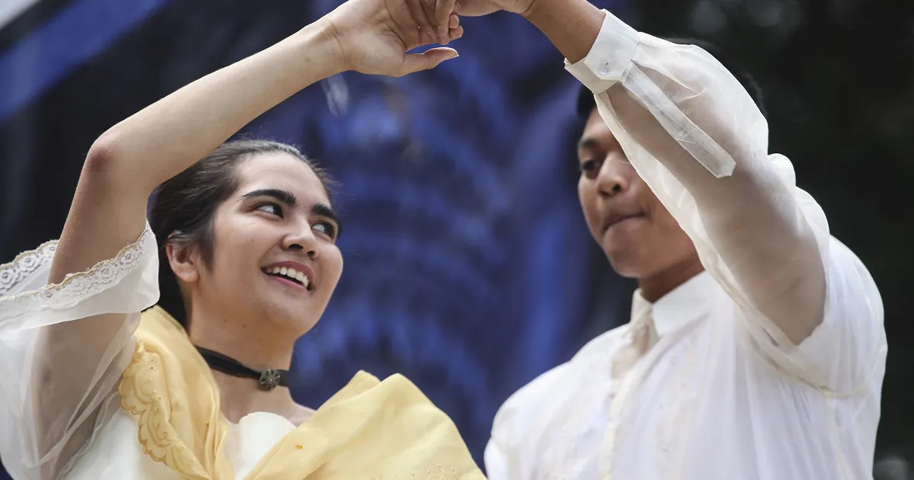
THANK YOU

